Slide 1

AI-Based Diabetes Prediction System
Machine Learning for Early Diabetes Risk Prediction
Project -
DSN2098 – Project Exhibition-I · Review: Review-2
Project Team
Aarjav Jain, Samarth Khare, Aryan Srivastava, Shubhankar Sharma, Ishan Bharti, Aryan Srivastava
Supervisor
Dr. Chayan Paul
Reviewer 1
Dr. G. Prabhu Kanna
Reviewer 2
Dr. Chayan Paul

Slide 2
Problem Statement And Objectives
Core medical focus and strategic goals of the prediction system
PROBLEM STATEMENT
OBJECTIVES
Early Diabetes Detection
Early identification of disease risk helps individuals seek timely medical advice.
01
Develop an ML-based system for disease-risk prediction
02
Analyse health parameters and extract predictive features
Health datasets (Diabetes) contain patterns that machine learning can help identify to produce a preliminary risk assessment.
03
Train and evaluate models using public datasets
04
Provide a clear, simple prediction output
05
Study practical AI applications in healthcare
Key Focus Area
Leveraging data-driven AI models for preventive healthcare and early clinical decision support.

Slide 3
Scope (Review-1 & Review-2)
Review-1 Scope
Review-2 Scope
Problem Definition & Dataset Selection: Focus on diabetes risk prediction using public datasets (e.g., UCI Repo).
Advanced Model Optimization: Hyperparameter tuning, ensemble methods (Random Forest), and cross-validation.
Data Preprocessing & Cleaning: Handling missing values, outlier detection, and feature normalization.
Complete Web Interface Integration:
Full interactive web application deployment using Streamlit..
Baseline Model Evaluation:
Train classical ML algorithms (Logistic Regression, Decision Trees) and compare preliminary accuracy.
System Testing & Final Presentation: End-to-end integration testing, error handling, documentation, and final demonstration.
Initial UI Prototype:
Build a minimal user interface concept for basic risk input/output.

Slide 4

Hardware & Software Requirements
Essential environment setup and libraries for disease prediction
Hardware Requirements
Software Environment
Proposed Python Libraries
Laptop / Desktop computer for development
Minimum 4 GB RAM
(8 GB recommended for optimal execution)
Python as core language (actively learning during project)
VS Code or Google Colab
as primary IDE environments
Public healthcare dataset
(extracted from kaggle)
Pandas — data handling and preprocessing tasks
NumPy — efficient numerical and array operations
Scikit-learn — machine learning model training & analysis
Matplotlib — data visualization
Streamlit — clean UI
Reliable internet connection for dataset access

Slide 5
Models Proposed in this Project
Random Forest Classifier, to address the specific challenges of your medical data
Baseline Model
Expanded Model
★ Final Proposed Model
Baseline Random Forest
(Top 8 Features)
Standard Random Forest
(21 Features)
An expanded model utilising the entire medical and socioeconomic profile to capture nuanced patient data.
Balanced Random Forest
(Optimized Weights)
The optimised model using the class_weight='balanced' parameter.
A lightweight model trained only on the most statistically significant predictors extracted via feature importance.
Key Predictors Included:
BMI
High BP
General Health
Challenge Identified:
Favoured majority class ("Low Risk") because healthy patients outnumber diabetic patients 218,000 to 35,000.
Key Solution:
Adjusts weights to heavily penalise mistakes on minority class (diabetic patients), forcing the model to identify high-risk patterns.

Slide 6
Architecture — Process Flow & Timeline
SYSTEM WORKFLOW & DEVELOPMENT PHASES
STEP 01 STEP 02
STEP 03
STEP 04
Data Collection
Gathering raw information from various sources.
Preprocessing
Cleaning and organising the initial data.
Model Training
Developing the algorithm with prepared data.
Prediction
Using the model to forecast future outcomes.
PROJECT TIMELINE (PHASES)
Phase 1
Phase 2
Phase 3
Phase 4
Phase 5
Literature review, dataset selection, learn ML basics
Data preprocessing and exploratory analysis
Model development and training
Testing, evaluation and refinement
Simple UI, documentation and final presentation

Slide 7
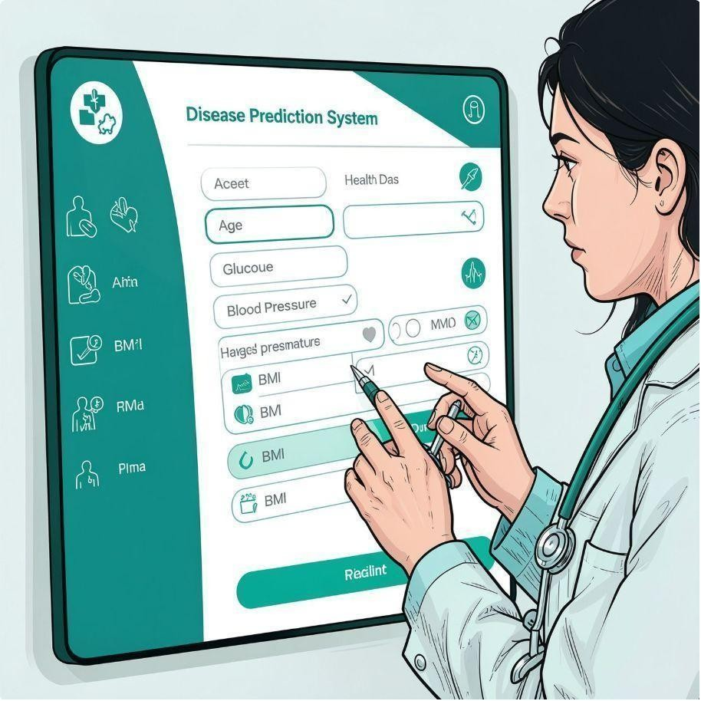
Usability & Applications
How it works (simpliﬁed)
Health Parameters (HighBP , HighCholestrol , Cholestrol check , BMI , Smoker , Stroke , HeartDiseaseorAttack , PhysicalActivity , Fruits , Veggies , Heavy Alcohol Consumption, AnyHealthcare , No Doctor because of Cost , General health , Mental health , Physical Health , DiﬃectiveWalk , Sex , Age , Education , Income)
→ Processed by trained ML model → Preliminary disease-risk prediction (risk level / probability estimate)
Primary Applications
Preliminary disease-risk assessment for awareness
Educational demonstrations of ML in healthcare
Dataset analysis and feature exploration
Support for early screening research (non-diagnostic)

Slide 8

GlucoScan: AI-Driven Diabetes Risk Assessment Portal
Key performance metrics evaluating clinical efficacy, predictive accuracy, and dataset foundation.
SYSTEM OVERVIEW
229,474
CLEANED PATIENT RECORDS
79.47%
CLINICAL RECALL (SENSITIVITY)
0.8187
TEST ROC-AUC SCORE
Rigorously preprocessed healthcare dataset structured for high-precision model training.
Optimized to identify potential diabetes risk early, minimizing false negatives in screening.
Demonstrates strong overall classification discrimination across test set evaluations.
Clinical Utility: GlucoScan synthesizes patient health parameters to deliver non-diagnostic preliminary risk estimates for early healthcare intervention.
Page 6

Slide 9
Reposed Team Contributions
Team Member
Proposed Responsibility (Review-0)
Aarjav jain
Dataset research & collection — identify public datasets and document attributes.
Samarth Khare
Data preprocessing — clean data, handle missing values, feature engineering.
Aryan Srivastava
Machine-learning model — study and implement suitable classical ML algorithms.
Aryan Srivastava
Model testing & evaluation — performance metrics, cross-validation and comparison.
Ishan Bharti
User interface — build a simple demo UI for entering parameters and showing results.
Shubhankar Sharma
Documentation & presentation — literature review, write report and prepare slides.

Slide 10
References & Documentation
Key datasets, technical documentation, and foundational research supporting the GlucoScan project.
SOURCES & RESOURCES
Kaggle.com
Source of public healthcare and disease datasets for research and education.
Scikit-learn Documentation
Reference for classical machine-learning algorithms, preprocessing tools, and evaluation metrics.
Python Documentation
Language reference and standard library documentation for core project logic.
Relevant Research
Peer-reviewed studies on ML approaches to diabetes and disease-risk prediction (literature review).
Streamlit Documentation
Used to build the interactive web app interface, including inputs, outputs, and real-time result display.
Pandas Documentation
Used for data loading, cleaning, preprocessing, and tabular manipulation throughout the project.
Page 9

Slide 11
Thank You!
GLUCOSCAN
Questions & Discussion
AI-Driven Diabetes Risk Assessment Portal

